Slide 1
Parking Occupancy Detection
Zhipeng Lin
Zhihan Lin
Junjie Li
Manuel Liu Wang

Slide 2
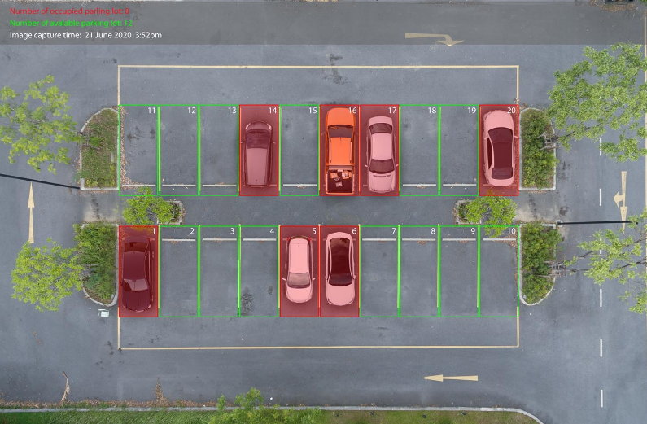
Goal
Environment/context
Main goal
Motivation and justification

Slide 3
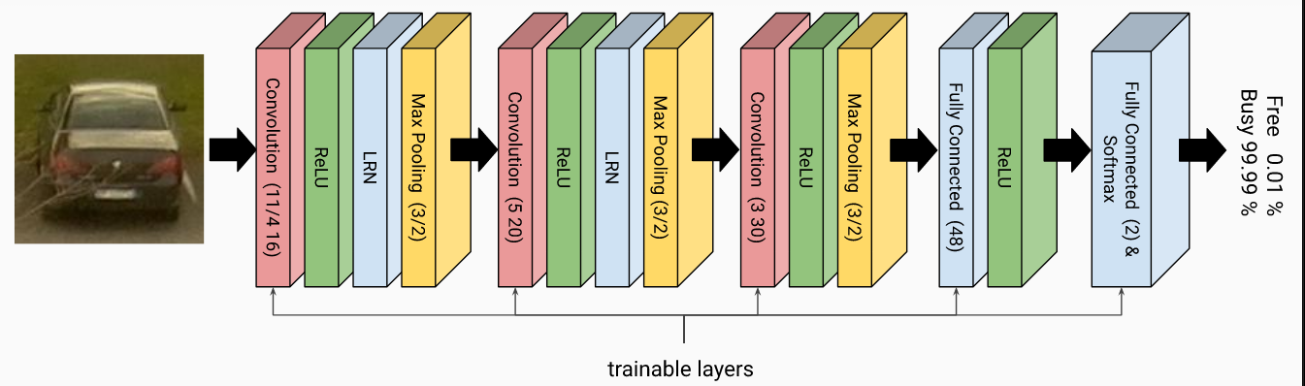
How was the problem solved?
Convolutional Layout
Rectified Linear Unit Layout
Subsampling Layout, Max Pooling
Backpropagation

Slide 4
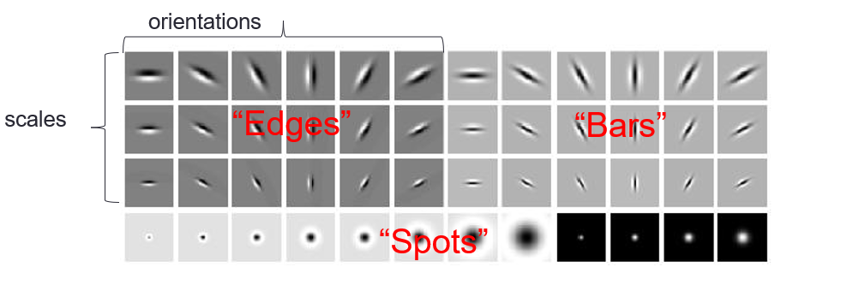
How was the problem solved?
Convolutional Layout

Slide 5
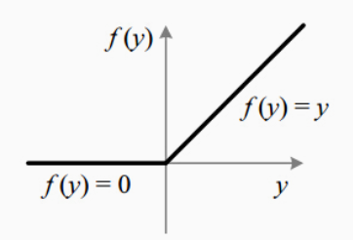
How was the problem solved?
Rectified Linear Unit Layout, activation function

Slide 6
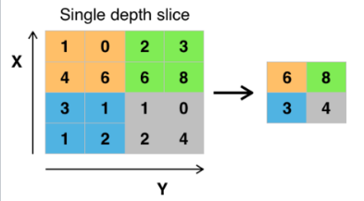
How was the problem solved?
Subsampling Layout, Max Pooling

Slide 7
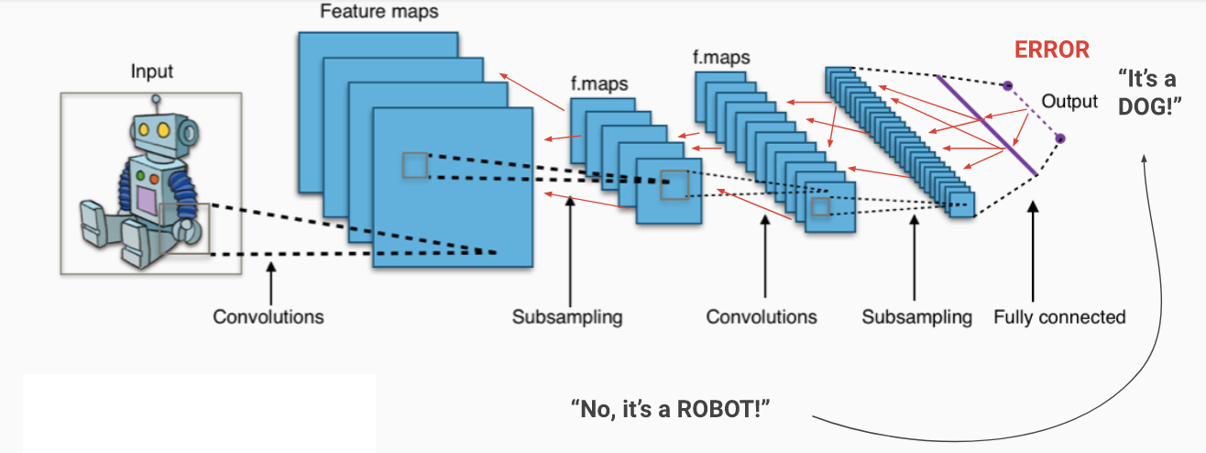
How was the problem solved?
Backpropagation

Slide 8
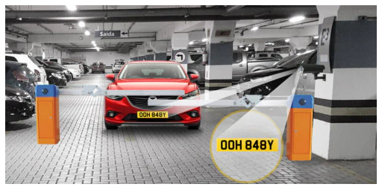
Possible extensions
License Plate Recognition

Slide 9
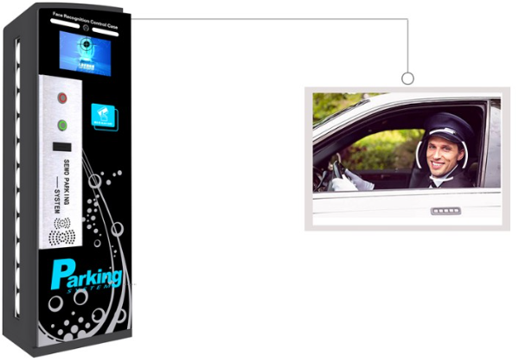
Possible extensions
Identify the owner

Slide 10
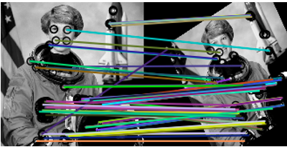
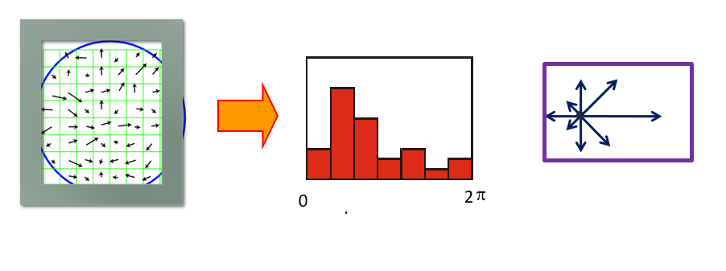
Relation to the Subject “Computer Vision” coursed at UB
License Plate Recognition
Image features
Sift for images feature extraction

Slide 11
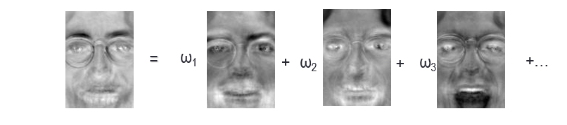
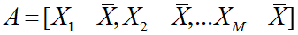
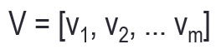
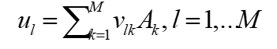
Relation to the Subject “Computer Vision” coursed at UB
2. Vehicle’s owner recognition
Face recognition

Slide 12
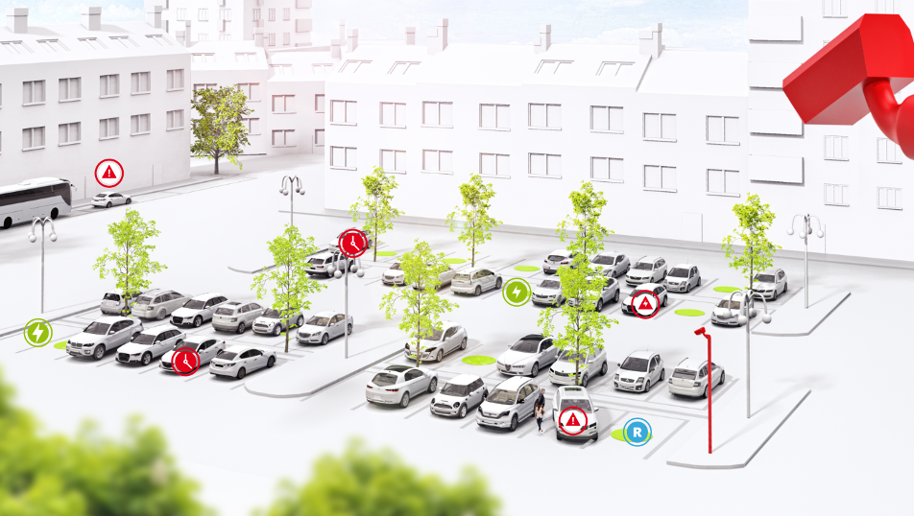
Conclusions and observations

Slide 13
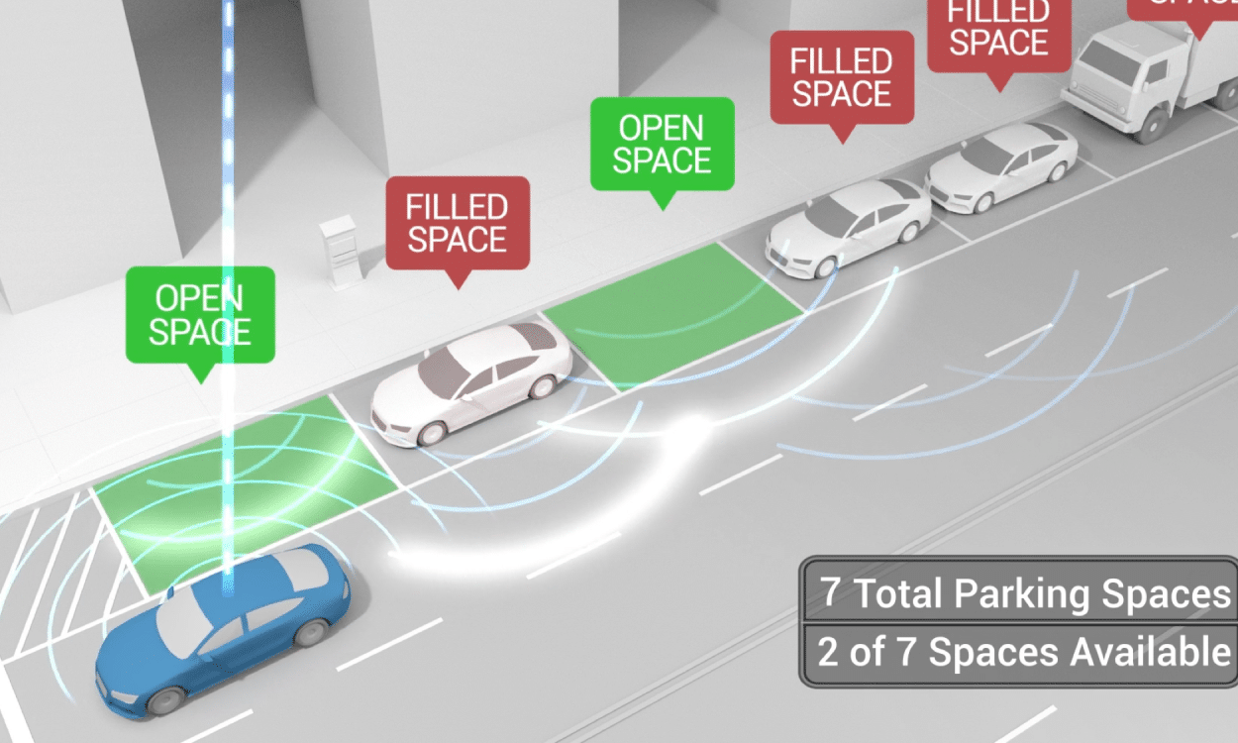

Slide 15
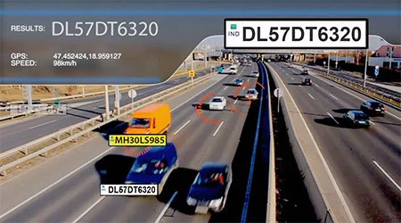
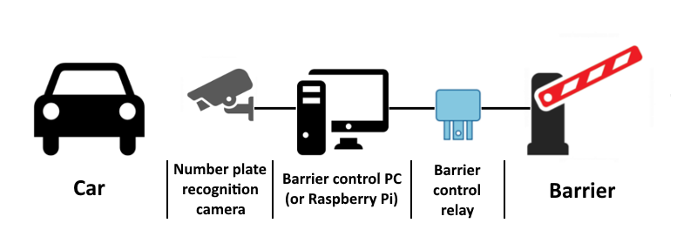

Slide 16
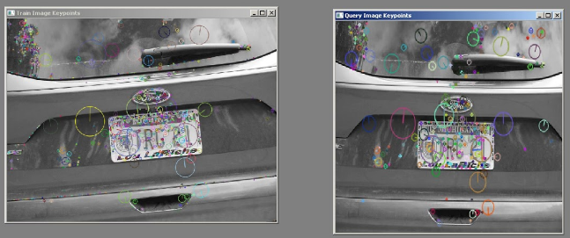

Slide 17
